Slide 1
Semester Project (Graph Theory)

Slide 2
Introduction
Document classification:
Document classification is the automated process of categorizing documents into predefined classes or categories based on their content. In our code context, document classification involves assigning each document to one of the predefined topics: Food, Lifestyle & Hobbies, or Marketing & Sales. This process enables efficient organization, retrieval, and analysis of large volumes of documents, facilitating tasks such as information retrieval, content filtering, and document management.
Classical / NLP based methods for document classification:
Bag-of-Words (BoW)
Naive Bayes
Decision Trees and Random Forests
Notes:
Bag-of-Words (BoW):BoW represents documents as vectors where each dimension corresponds to a unique word in the vocabulary. The value of each dimension represents the frequency or presence of the word in the document. These vectors are then fed into machine learning algorithms for classification
Naive Bayes:Naive Bayes is a probabilistic classifier based on Bayes' theorem. Despite its simplicity, it often performs well in document classification tasks, especially when the independence assumption between features holds reasonably well.Decision Trees and Random Forests:Decision trees and random forests are tree-based models that can be used for document classification. They partition the feature space into regions based on the values of the features and make predictions based on majority voting in the case of random forests.

Slide 3
Use of Graphs
Here are the steps for graph-based document classification:
Representation: Convert documents into graphs, where nodes represent elements like words or phrases, and edges represent relationships such as co-occurrence or proximity.
2. Feature Extraction: Extract features from the document graphs, such as graph metrics, node centrality, or subgraph patterns.
3. Modeling: Use machine learning algorithms to train a classifier on the extracted graph features to predict document categories or labels.
Notes:
Graph Construction: Represent words as nodes and define edges based on relationships (e.g., co-occurrence, syntactic dependency). Construct the graph using network or similar libraries.
Feature Extraction: Calculate node-level features (e.g., centrality measures) and graph-level features (e.g., average shortest path length). These features capture structural and semantic information within the document graph.
Classification: Convert graph-based features into feature vectors for each document. Train a machine learning classifier (e.g., SVM, Random Forest) on these feature vectors for document classification.

Slide 4
Problem Statement
Project Description:-
The project involves classifying documents into predefined topics. Each document contains text content related to one of these topics. The goal is to automatically classify new documents into these categories based on their content.
Method Used:
Graphs from Text: Documents converted to graphs; words as nodes, relationships as edges.
Distance Computation: Calculates node distances for structural insights.
KNN Classification: Uses features for document similarity classification
.
Performance Metrics: Confusion matrices, accuracy assess model efficacy.
Notes:
Method Used: Additionally, the maximal common subgraph size between pairs of documents is computed to measure the similarity between documents.- These graph-based features, along with the calculated distances, are used as input features for a K-Nearest Neighbors (KNN) classifier.- The KNN classifier is trained on the training data consisting of labeled documents to learn patterns and relationships between features and labels.- Once trained, the classifier is used to predict the labels (topics) of new, unseen documents based on their features.- Finally, the performance of the classifier is evaluated using metrics such as confusion matrix and accuracy to assess its effectiveness in classifying documents into the correct topics.

Slide 5
Methodology
Web Source (e.g., Websites)
1. Web Scraping
2. Data Cleaning
Cleaned Text Data
Confusion Matrix
Raw Text Data
3. Graph Creation
6. Testing
4. Method Implementation
Graph
Features for Classifying
Trained Model(36 Files)
5. Training KNN Model

Slide 6
Methodology
Web Scraping: Gathered data from online sources using tools like BeautifulSoup or Scrapy.
2. Data Cleaning: Removed noise, performed tokenization, and applied techniques like stemming or lemmatization to prepare the text data.
3. Graph Creation: Constructed graphs where nodes represent words and edges represent relationships (e.g., co-occurrence).

Slide 7
Methodology
4. Method Implementation: Utilized graph-based algorithms or traditional NLP methods for document classification, leveraging features derived from the constructed graphs.
5. Training KNN Models : Used the training data to train multiple KNN models with different parameters, such as the number of neighbors (K).
6. Testing : Evaluated the trained KNN models using separate testing data to assess their performance in classifying documents into predefined categories.

Slide 8
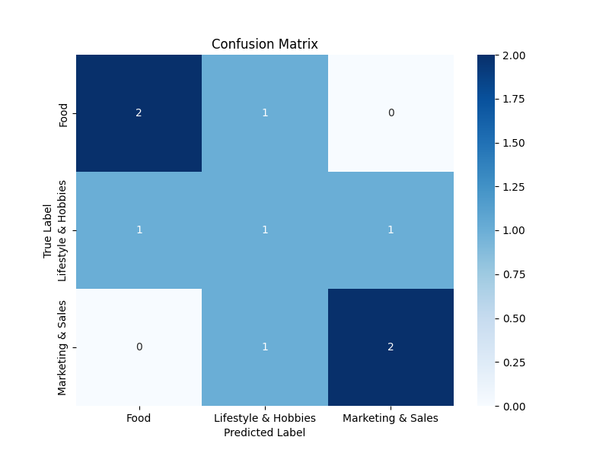
Results
Accuracy: 56%
Notes:
The confusion matrix summarizes the performance of a classification model. Here's how to interpret the given matrix:
- The rows represent the true classes or labels of the documents, while the columns represent the predicted classes.
- Each cell in the matrix indicates the count of documents that belong to a specific combination of true and predicted classes.
- For example:
- The cell at (1,1) indicates that one document from class 1 (true label) was correctly classified as class 1 (predicted label).
- The cell at (2,2) indicates that two documents from class 2 were correctly classified as class 2.
- The cell at (3,3) indicates that three documents from class 3 were correctly classified as class 3.
- Off-diagonal cells represent misclassifications:
- For instance, the cell at (1,3) indicates that two documents from class 3 were misclassified as class 1.
- Overall, the confusion matrix provides insights into the model's performance, highlighting areas of correct and incorrect classification.

Slide 9
Future Work
Some potential modifications and new ideas for document classification:
1. Feature Engineering
2. Ensemble Methods
3. Deep Learning Models
4. Active Learning
5. Semi-supervised Learning
6. Domain-Specific Features
7. Error Analysis and Iterative Refinement
8. Multi-label Classification
Notes:
Certainly! Here are some suggestions and new ideas for document classification:
1. **Feature Engineering**: Instead of relying solely on graph-based features, consider incorporating other features such as word embeddings, TF-IDF vectors, or document embeddings obtained from pre-trained language models like BERT or GPT.
2. **Ensemble Methods**: Combine predictions from multiple classifiers, such as KNN, Naive Bayes, Decision Trees, etc., using ensemble methods like majority voting or stacking to improve overall classification accuracy.
3. **Deep Learning Models**: Explore the use of deep learning architectures like Convolutional Neural Networks (CNNs), Recurrent Neural Networks (RNNs), or Transformer-based models for document classification tasks, which may capture complex patterns and dependencies in the data more effectively.
4. **Active Learning**: Incorporate active learning strategies to intelligently select informative samples for annotation, thereby reducing the annotation effort required for training while maintaining high classification performance.
5. **Semi-supervised Learning**: Utilize a combination of labeled and unlabeled data for training, leveraging techniques like self-training or co-training to make use of unlabeled data and improve classification performance.
6. **Domain-Specific Features**: If available, incorporate domain-specific features or metadata associated with the documents (e.g., author information, publication date, source) to enhance the classification model's accuracy and interpretability.
7. **Error Analysis and Iterative Refinement**: Perform thorough error analysis on misclassified documents to identify recurring patterns or challenges. Use this feedback to iteratively refine the classification model and preprocessing steps.
8. **Multi-label Classification**: If documents can belong to multiple categories simultaneously, explore multi-label classification techniques to assign multiple relevant labels to each document accurately.

Slide 10
Q & A

